Slide 1
Rate Design
2024 Michigan State
Institute of Public Utilities
Advanced Course
Jay Zarnikau

Slide 2
Who is Jay Z? (The other one)
I started my career in 1983 at the Public Utility Commission of Texas (PUCT), doing adjustments to billing determinants. Testified on rate design in many rate cases. Served as the PUCT’s Director of Electric Utility Regulation for four years.
I’ve testified at ten different regulatory commissions. Most of my testimony has been on rate design issues.
Since leaving the PUCT, I’ve worked or testified on pricing issues for utilities, large industrial energy consumers, residential energy consumer groups, and cities.
I’ve conducted some pricing experiments and have conducted evaluations of pricing programs and experiments.
I also teach applied statistics and energy economics at The University of Texas.

Slide 3

Agenda
  Topic 1: Ratemaking under Cost-of-Service Regulation
  Topic 2: Common Rate Structures in a Regulated Setting
  Topic 3: Pricing in Restructured Retail Markets
  Topic 4: Theory and Practice: Dynamic Pricing
  Topic 5: Economic Theory: Priority Service
  Topic 6: Price Signals for better Equipment Purchase Decisions
  Topic 7: Pareto Improvement as an Objective
  Topic 8: In an Era of faster growth in electricity demand
  Topic 9: The Smart Grid and Pricing in Distribution Networks
  Topic 10: Energy Collectives
  Topic 11: Summary

Slide 4

Topic One
  Rate Making under Cost-of-Service Regulation

Slide 5
Ratemaking Under Cost-of-Service Regulation
Revenue Requirement
Cost of Service
Rate Design

Slide 6
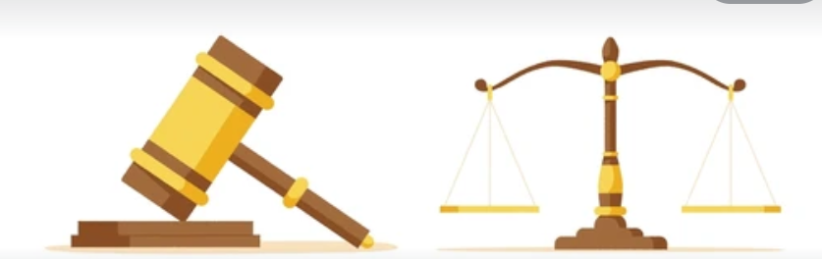
Purpose
  Rates must be “just and reasonable.”
  Provide a regulated utility with a reasonable opportunity to collect its revenue requirement (reasonable and necessary costs which were prudently incurred, including some return on rate base)
  We can use “price signals” to affect consumer behaviors

Slide 7
Additional Objectives
Align prices with the costs of serving consumers.
Revenue sufficiency, rate stability, and predictability
Discourage wasteful use of electricity
Environmental protection and reduce pollution
Fairness in the allocation of costs among customers
Avoid undue discrimination (minimize subsidies)
Promote innovation and respond to changing demand-supply patterns
Simplicity, certainty, convenience of payment, economy in collection, understandability, public acceptance, feasibility in application
Use price as a signal to promote economically-efficient consumption behavior
Advance economic development goals
Customer Acceptance
There may be conflicts among these objectives
An old reference: James Bonbright, Principles of Public Utility Rates, 1961. I have updated his list a little.

Slide 8
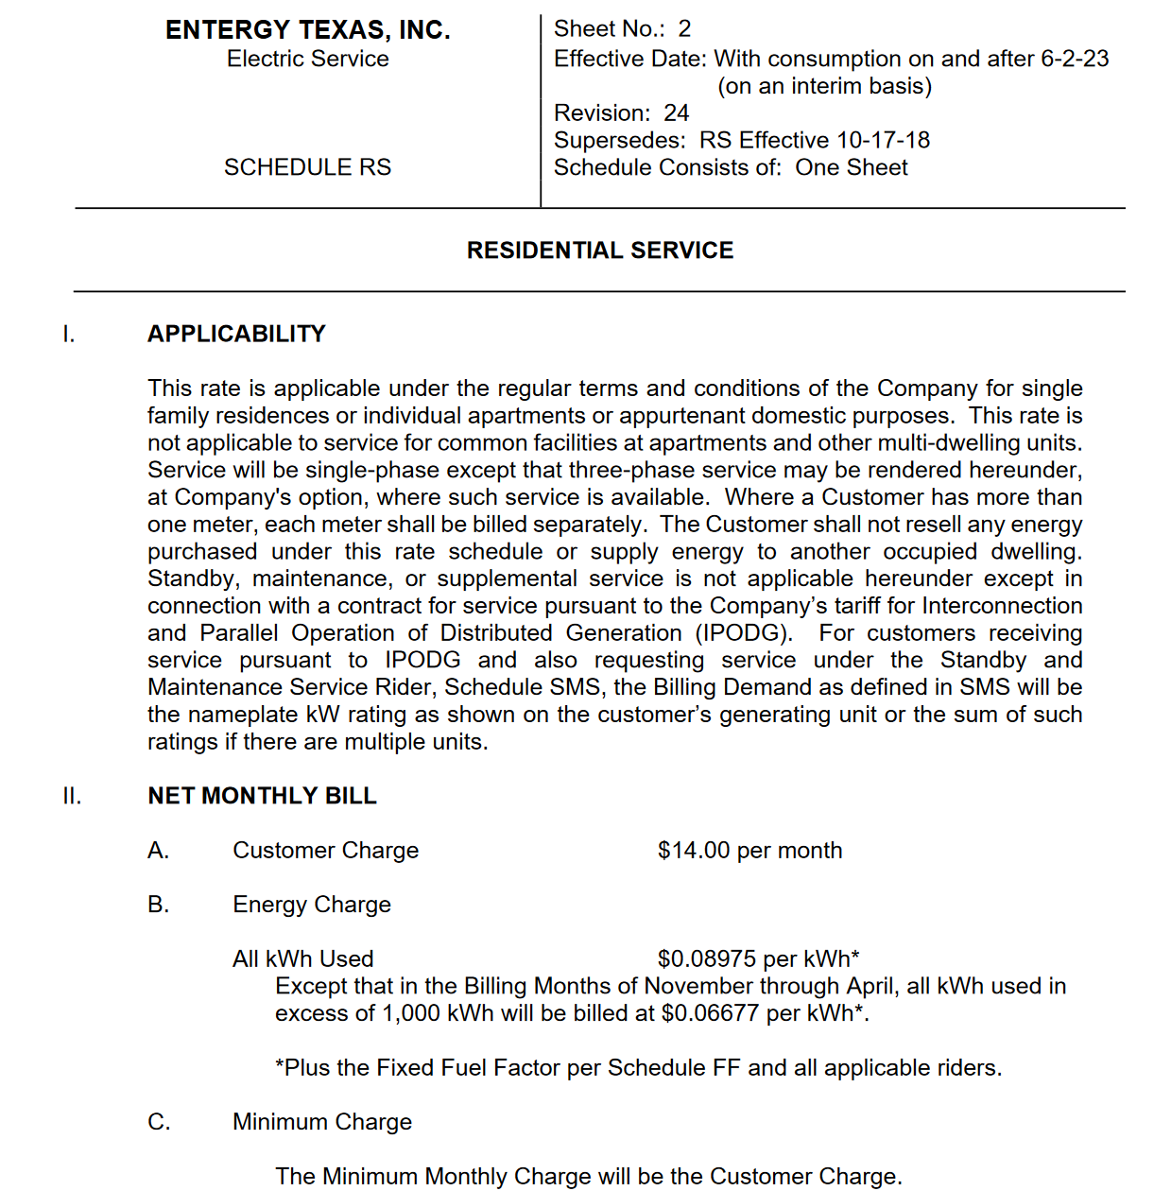
Tariff Sheets
Rules and Regulations
Service Characteristics
Rates. Charges per kWh of energy consumption, charges per kW of demand, per account, etc.
Ratemaking under cost-of-service regulation

Slide 9
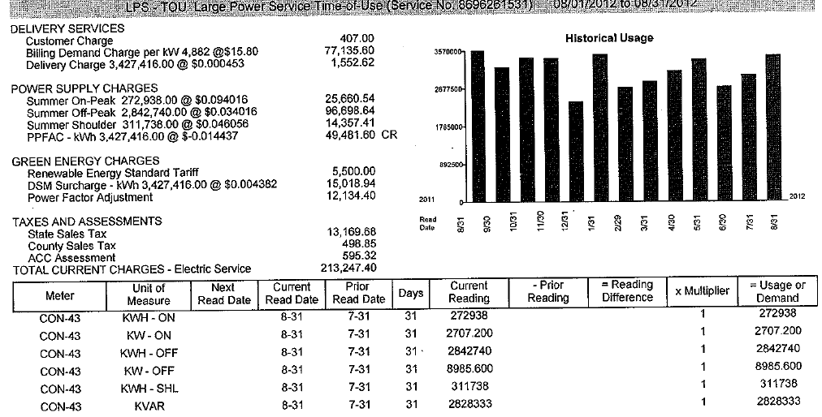
Rates, a Breakdown
Customer charges recover the costs of the infrastructure needed to access the grid (e.g., a meter, distribution, transformers, billing, customer service). This fixed monthly charge does not vary with consumption.
Demand charges typically recover the cost of providing transmission and distribution service (and perhaps power plants) to the consumer based on the customer’s maximum demand over a period of time, or the customer’s contribution to the system peak in a season or month. A ratchet might apply, whereby the billed demand level in kW be the larger of the actual peak demand for the billing period, or a percentage of the highest peak reached during the previous X months. This is typically not applied to residential energy consumers.
Energy charges to cover the variable costs. Often energy charges will include a fuel factor to recover fuel costs incurred by a utility provider with its own power plants, a purchased power cost recovery factor to recover purchased power costs, and an additional energy charge to recover variable operation and maintenance expenses incurred by the utility in providing service.
Other charges may include taxes, nuclear decommissioning charges, energy efficiency program cost recovery, etc.

Slide 10
Billing Units or Billing Determinants
To determine rates, we need to divide costs (the numerator) by a denominator
Energy (kWh)
Billing kWh = Usually current consumption for a billing period (e.g., ~30 calendar days) for the customer class
Customer or Meter
The number of accounts or meters multiplied by 12 (assuming monthly billing to recover costs)
Demand (kW)
Maximum kW within a period (e.g., month, year). Often a non-coincident peak or “NCP” value.
Connected kW based on the total power draw of a customer’s electricity consuming equipment
Ratchet kW (e.g., maximum kW in the last 12 months)
A contract amount
The billing determinant is the total billed demand or sum of the individual customers’ demand in the class over all 12 months in the test year.

Slide 11

Billing Units or Billing Determinants
To determine rates, we need to divide costs by a denominator
Also. . . .
For street lighting, the number of bulbs might be a billing determinant.
For transmission, the billing determinants might be the customer’s contribution to system demand during system peaks. Texas (ERCOT) uses demand during the 15-minute intervals with system peaks in four summer months (4CP pricing). In PJM, four or five peak values may be used.
Or, the demand charge might be the customer’s maximum demand, regardless of when it occurs. (The NCP.)
What demand measurement was used to allocate costs among rate classes?

Slide 12
Development of Rates from Costs and Billing Determinants
Adjusted test year values vs. projected values?
Adjustments to billing determinants for “known and measurable” or “reasonably predictable” changes from test-year actual values?
Reference: Ken Costello, Future Test Years: Challenges Posed for State Utility Commissions, NRRI, 2013.

Slide 13
Assuming the standard practice involves adjustments to the actual billing determinants in an historical test year. . . .
Adjust kWh sales to remove the effects of abnormal weather using a regression model.
Adjust customer counts for customer growth (or decline).
Specific adjustments to reflect changes in large industrial energy consumers (e.g., the expansion or closure of a manufacturing plant, a new large industrial energy consumer, etc.).
Adjust for the price elasticity of demand – i.e., how the proposed rate change might impact sales to consumers. (This is not commonly accepted, but was allowed in Texas in the early 1980s.)

Slide 14
The Mechanics
Use the revenue requirement or cost of service for each customer class or rate class.
Determine what type of rates will be charged to recover cost of service from each class. (For example, will demand charges be used to recover demand-related costs from residential energy consumers?)
What level of annual costs will be recovered through which charges?
For each class, divide costs to be recovered through each charge by the billing determinants applicable to each charge to obtain a rate.

Slide 15
Examine how the Cost-of-Service study classified costs as customer-related, energy-related, demand-related, etc.
Costs may be incurred for numerous reasons: to generate electricity, to fund power plants, provide transmission and distribution infrastructure, to fund metering and billing functions, etc.
But we also need to consider metering capabilities. We can’t recover residential demand-related costs via a demand charge if the utility uses older metering systems.

Slide 16
But What if Cost Causation is not “clear-cut”?
In Texas for many years, it was generally accepted that transmission costs were incurred to meet total system demand.
But, in recent years, this has been challenged.
  A lot of transmission investment has gone into accommodating the energy from wind power projects in West Texas.
  We invest in transmission after hurricanes hit the Gulf Coast.
  Transmission investments are made to help electrify oil and gas pumping and pipelines.

Slide 17
What if Cost Classification is not “clear-cut”?
Was that power plant built to provide energy or provide reliability during peak periods?
Are maintenance expenses fixed (demand-related) or variable (energy-related)?
What should we do about administrative overhead?
What is that battery energy storage system going to be used for?

Slide 18
Should we “Direct Assign” costs? Or “Socialize” costs?
Was the investment made for the benefit of a single customer? If so, should we design a rate for a particular customer?
Does the investment benefit all customers? If so, should everyone contribute to cost recovery?
Does the investment benefit a certain type of customer?
Was the investment to improve reliability in a specific geographic area?

Slide 19
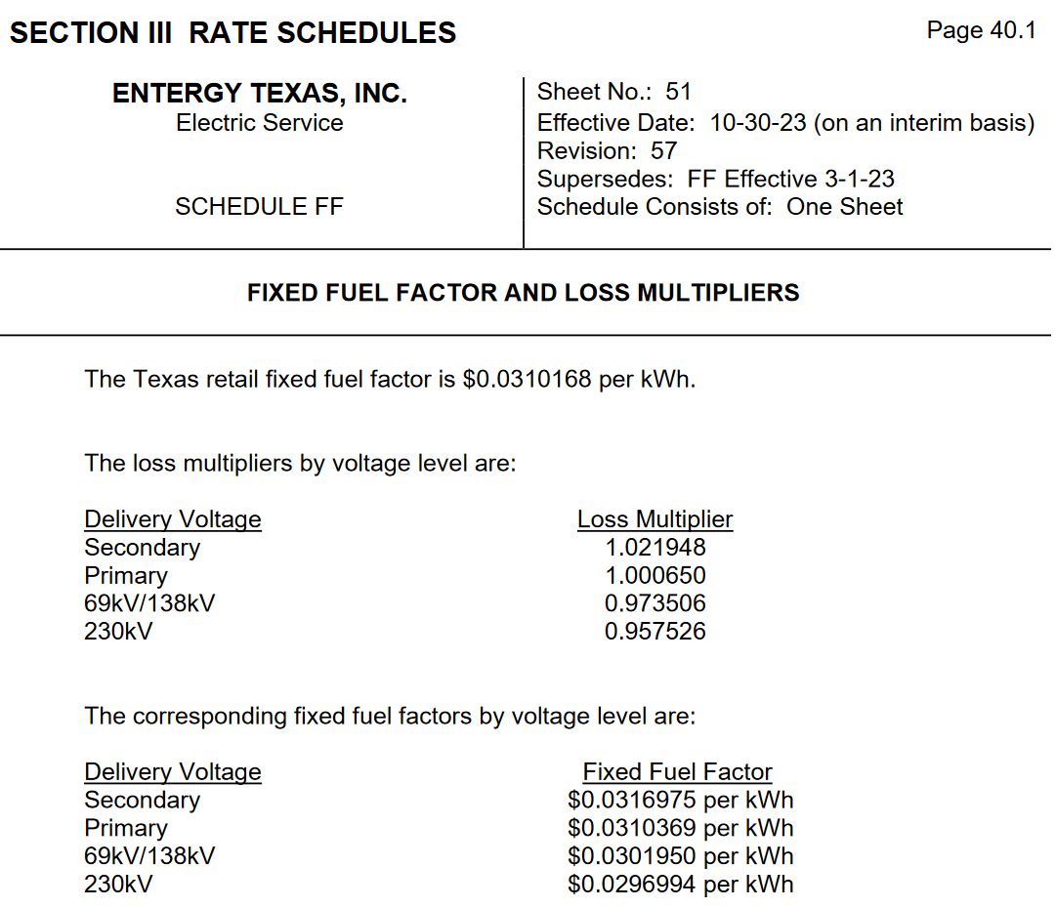
Rate Adjustments
Some components of cost-of-service may be adjusted on a periodic basis between general rate cases
Fuel costs
Purchased Power costs
Energy efficiency program costs
Taxes
This is often achieved through Rate Riders or Adjusters
For costs and rates subject to periodic adjustment, there may be a regulatory review and reconciliation in a subsequent rate case or other regulatory proceeding where prudence and reasonable and necessary standards are applied.

Slide 20
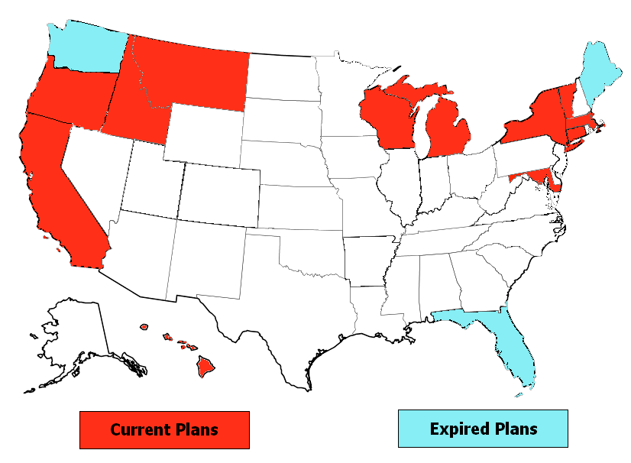
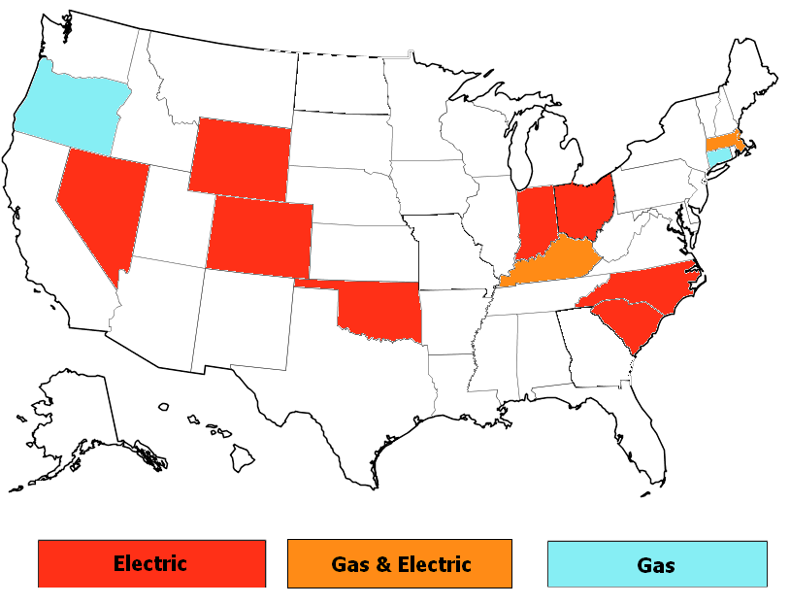
Are there Policies to Promote Energy Efficiency which Impact Rates?
Electric Decoupling Plans
Lost Revenue Adjustment Mechanisms
Note: I’m not sure how “updated” these maps are.

Slide 21
Are there Policies to Promote Energy Efficiency which Impact Rates?
Lost Revenue Adjustment Mechanisms (LRAMs) compensate the utility for the margins or earnings lost as a result of reduced sales. The impacts of energy efficiency programs upon the utility’s sales are estimated. The under-recovery of earnings or margins resulting from energy efficiency programs is then calculated. Adjustments or true-ups are undertaken to compensate the utility for the earnings foregone as a result of its investment in energy efficiency.
Decoupling seeks to fully divorce earnings and revenues from sales, thus removing the “throughput incentive.”
Allowed revenue or allowed revenue per customer is calculated. Rates are periodically adjusted through true-ups to ensure that the utility receives its allowed revenues or margins. The revenue collection allowed by the regulatory authority may be either increased or decreased under decoupling. As a result, actual utility revenues track projected revenue requirements despite unexpected fluctuations in sales.
Bottom line: These regulatory mechanisms are likely to complicate rate-setting.

Slide 22
Topic Two
Common Rate Structures in a Regulated Setting

Slide 23
Flat Rates
Simple charges per kWh of consumption. As energy usage increases or decreases, the energy charge changes proportionately.
Fixed customer charges.
Perhaps a demand charge.
A Proof of Revenue Statement can easily be constructed to ensure that the proposed rates charged to customers will generate sufficient revenue to cover the utility's approved revenue requirement.

Slide 24
Rate Structures are often used to provide Price Signals
Encourage Conservation of Energy (e.g., increase the cost per kWh if usage increases).
Promote Efficiency (and lower costs in the long run) by better matching Prices with Costs over Time
  In particular, seek to reduce consumption of electricity during peak or high- cost times through consumption behaviors and investment decisions.
  Encourage the shifting of consumption to lower-price periods.
  This promotes efficiency, reliability and better utilization of the utility system.
Encourage economic development.

Slide 25
Inclining Block Pricing
The more you consume, the higher your average price.
Advantages:
Promotes energy conservation
You can implement this using old metering technology that just measures cumulative consumption
Disadvantages:
Does not reflect temporal changes in the cost of providing the utility service

Slide 26
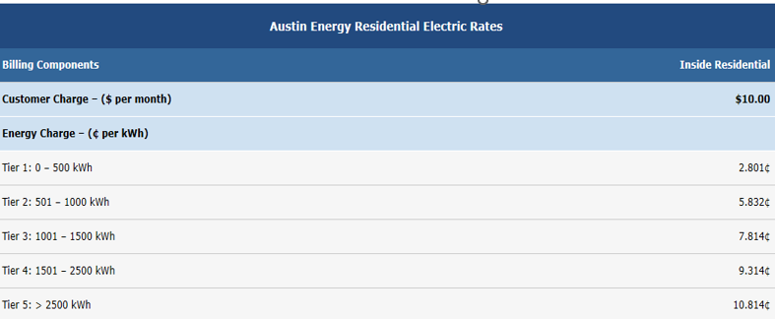
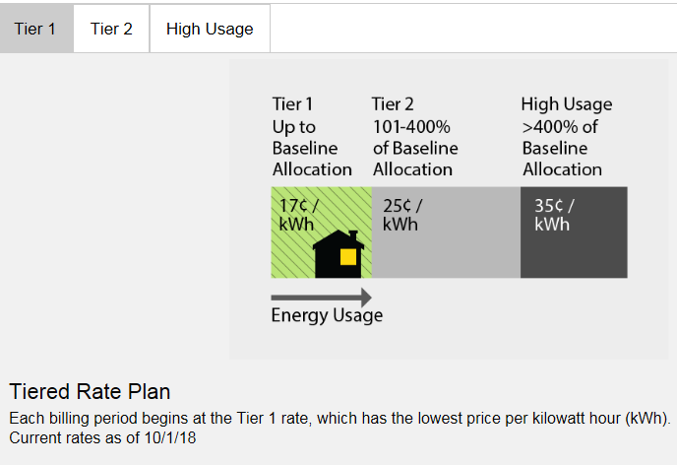
Southern California Edison (old)

Slide 27
Seasonal Rates
Charge more during months when generation costs are expected to be higher. Lower the price in months when costs are less.
Rate structures

Slide 28
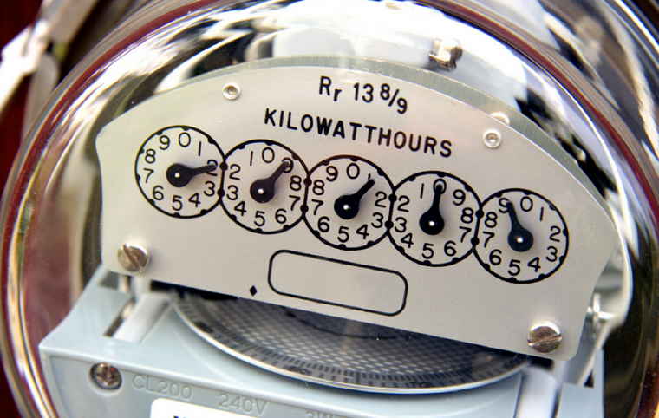
Metering Systems Matter
Traditional residential electric meters could only tell you how much energy the home or business used since the meter was installed. If you read the meter on April 1st and the reading was 10,000 kWh and read 11,000 kWh on May 1st, there was 1,000 kWh electricity consumption at the home in April.
You can’t match the consumption to particular hours or minutes. You can’t determine the maximum hourly consumption over the course of a month.
These are fine for block pricing. But. . . .

Slide 29
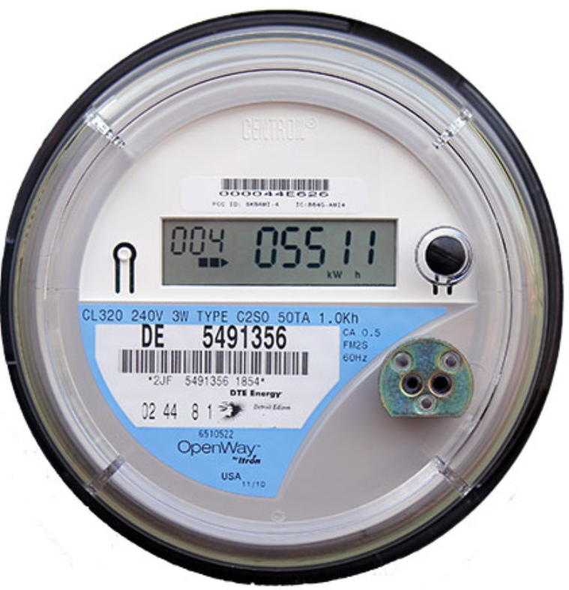
Advanced Metering Systems Enable Temporal Pricing
With advanced meters, you measure and store consumption information for every hour or 15-minute period.
You can retrieve the usage information remotely. No need for a meter reader.
You can also detect outages – locations where the meter can’t be read.
This enables many more pricing options.

Slide 30
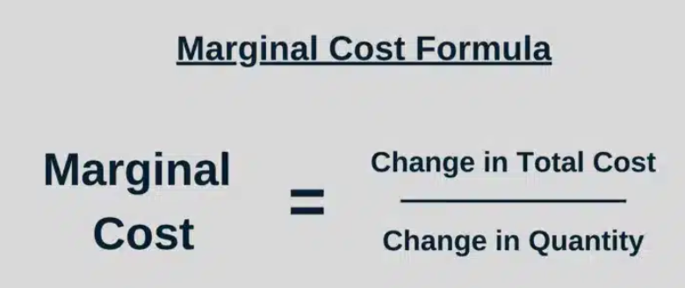
Before we get too far into temporal or dynamic pricing, I need to explain marginal cost. . . .
Marginal cost: The cost associated with meeting an additional unit of demand.
This can vary over time and geographically.
If the cost includes environmental externalities (e.g., CO2 emissions), we might call this Social Marginal Cost.

Slide 31
If Price Reflects Marginal Cost
  Utilities or producers see clearer signals for investing in technologies or practices that lower marginal costs (e.g., energy storage, renewable energy, or demand response technologies).
  Consumers are incentivized to adopt energy-efficient appliances or practices to minimize costs
  Consumption decisions align with the true cost of providing that service, avoiding overconsumption or underconsumption.
  Customers might shift usage to off-peak hours if the marginal cost of electricity is lower at those times.
  Those who use more resources during expensive times bear a greater cost burden.

Slide 32
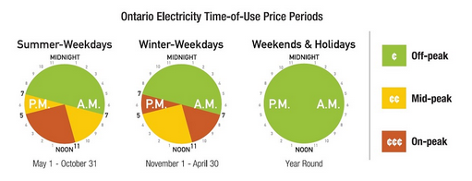
Time of Use (TOU) Pricing
Charge more during periods of higher demand and higher costs (e.g., summer weekday afternoons) than other periods (e.g., weekends, mornings, evenings).
Establish (pre-determine) the pricing periods.
Often, there will be three pricing periods.
This was encouraged by President Carter’s Energy Plan in the late 1970s.

Slide 33
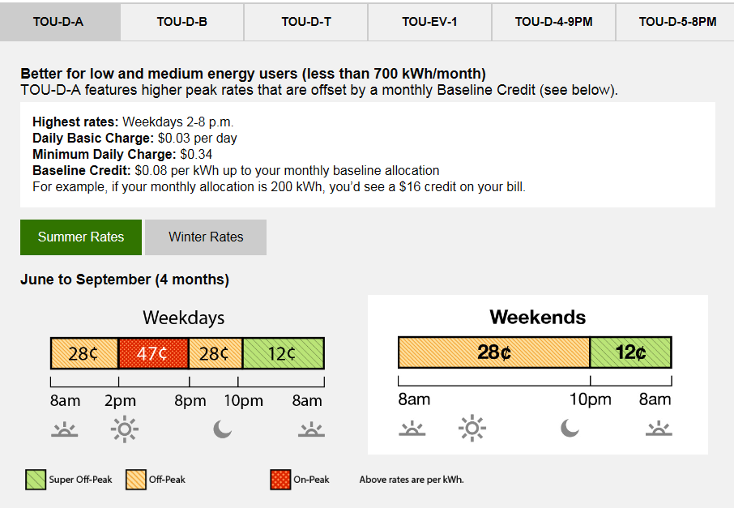
Southern California Edison’s (old) TOU rates

Slide 34

Critical Peak Pricing
Raise the price to very high levels up to 20(?) hours per year, when a high wholesale price or high demand is anticipated.
Otherwise, TOU pricing is in place.
This is becoming very popular (the California utilities, Georgia Power, Baltimore Gas and Electric, ComEd, etc.)

Slide 35
TOU Tariff with Dynamic Super-Peak Price (Combine TOU and Critical Peak pricing)
Sunday Monday Tuesday Wednesday Thursday Friday Saturday

Slide 36
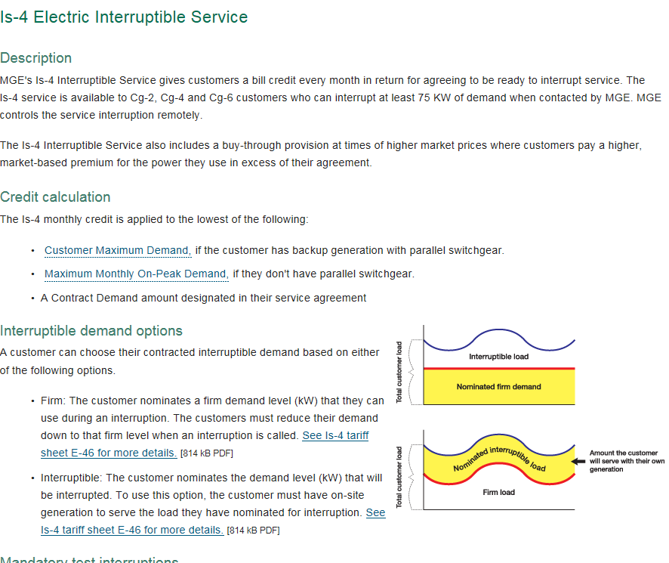
Interruptible Service
Customers subscribe to
lower reliability service
in return for a lower price.
Provides a means of rationing
electricity when there is a
shortage of generation.
In some jurisdictions, no need
to hold reserves to meet
the needs of interruptible
energy consumers.
In some markets, can be used
as an operating reserve.
Tariff Example from Wisconsin

Slide 37
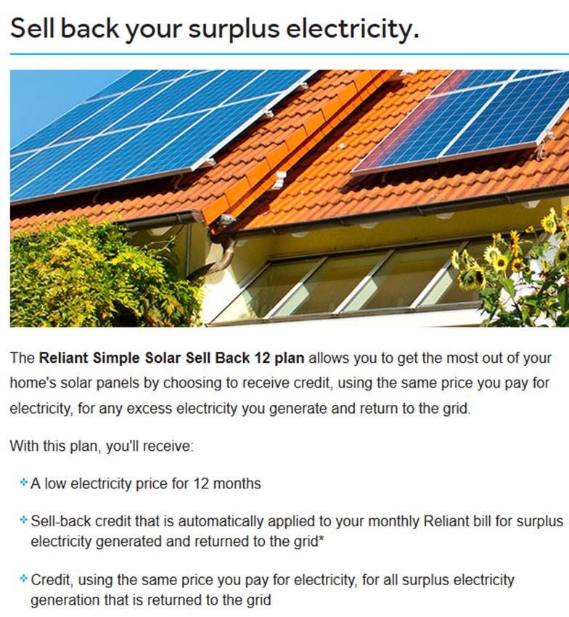
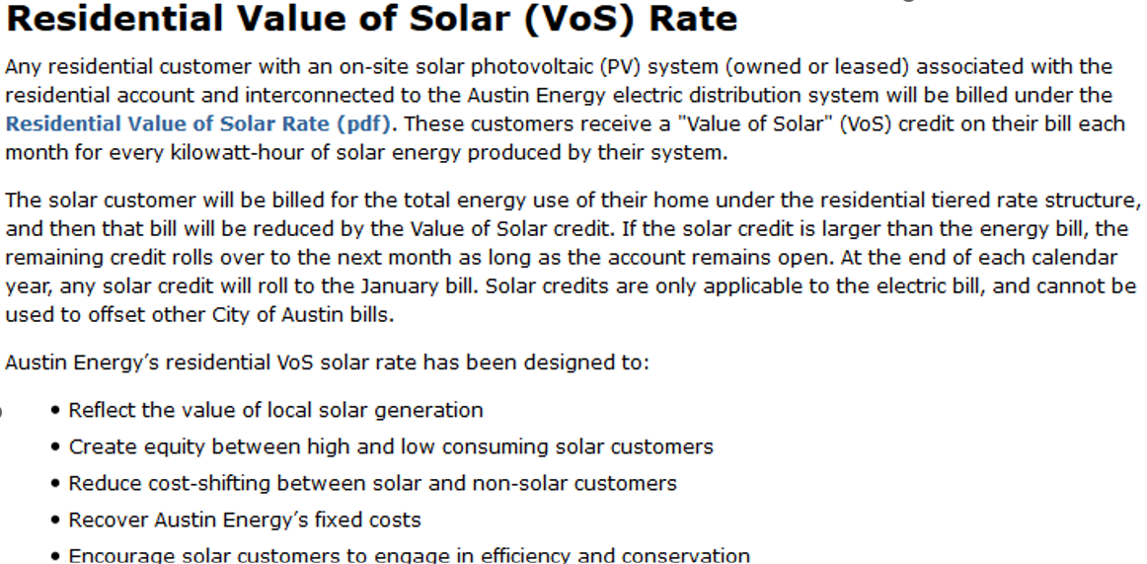
For Consumers with Rooftop Solar
  Pay for the net export of energy back to the grid each hour or interval that there is a net export?
  Pay for the net monthly export of energy back to the grid?
  Charge the consumer for all electricity used at the premise and credit or pay the consumer for all the electricity generated by the PV system at the customer’s site?
  This gets complicated if there are “blocks” in the usage charges.

Slide 38
Subsidized Rates for Lower Income Consumers?
Sometimes called “lifeline rates.”
Lower the first block of an increasing (inclining) block rate below cost, to provide a discount to consumers with low consumption. (Doesn’t work very well, since low-income consumers do not necessarily have low consumption.)
Alternatively, provide a discount to consumers who “qualify” as low income (e.g., are receiving various government benefits).

Slide 39


Income-Based Demand Charges
What??
This is suggested in Borenstein, Fowlie, Sallee, Designing Electricity Rates for an Equitable Energy Transition, UC-Berkeley.

Slide 40
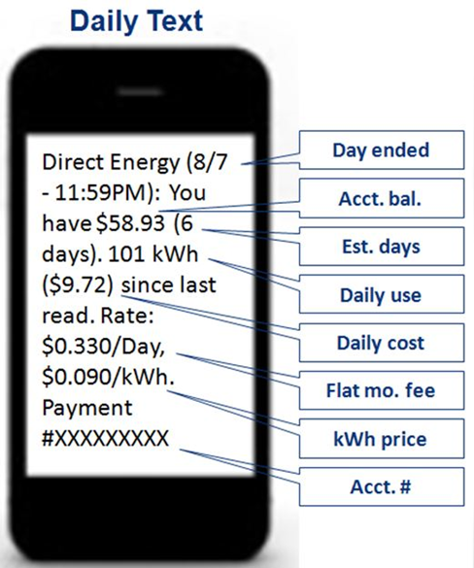
Prepayment
Pay in advance. If your balance drops to zero, you are cut off.
Benefits:
  Eliminates customer credit risks; reduces write-offs.
  Reduces cross-subsidies to those who fail to pay their electric bill.
  Has a very large conservation effect – usually over 10%.
  No need to send bills.
  Consumers receive useful price and usage information.
Disadvantages
  It is not for everyone. Someone with medical needs. shouldn’t be put on it.
  It tends to be more expensive.

Slide 41
How High to Make the Customer Charge?
Should we recover some customer-related costs through an energy charge (rather than through a customer charge) to provide a larger conservation signal (i.e., make the consumers’ bill more sensitive to the volume of electricity consumed)?
But “revenue stability” is enhanced if we recover more costs through a customer charge. The customer charge is not “weather sensitive.”
If a consumer installs rooftop solar, the utility might not recover the full cost of serving that customer if some customer-related costs are recovered through an energy charge rather than the customer charge.

Slide 42
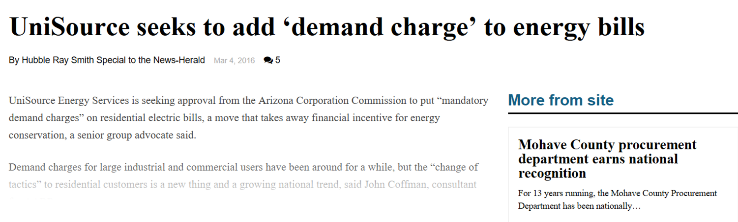
Residential Demand Charges?
Consumers are likely unaware of their monthly demand and might not know how to respond to a demand charge.
There may be a need for consumer education regarding demand charges.
There will be some implementation costs.
If you do not recover demand-related costs through a demand charge, you will need to recover those costs through the customer charge, the energy charge, or both.
In theory, it makes sense to recover demand-related costs through a demand charge, if the metering system will facilitate this.
But moving to a pricing system with demand charges will create certain winners and losers.

Slide 43
How Should Demand be Measured?
Should demand charges reflect the customer’s maximum demand or the customer’s demand at the time of the system peak? This is an interesting question, since:
  Investments in the distribution system may be made to accommodate the maximum demand of each customer.
  Investments the generation and transmission segments of the industry are often made with the objective of meeting total system demand.
Increasingly, transmission investments are made to move renewable energy to load centers –- which may arguably be more related to meeting energy needs than demand.
More than one demand charge?

Slide 44
Other Rate Design Issues that Often Arise in Rate Cases
Include fuel and purchased power in base rates or in a separate fuel factor?
If a tariff has a block structure: How many blocks? What are the cut-off points?
Demand ratchets for industrial energy consumers?
Special economic development rates?
Allow industrial energy consumers to shop for energy from sources other than the utility?

Slide 45
And, Finally, Gradualism
There may be a desire to move revenues (and thus prices) toward class cost of service in a gradual manner.
This provides consumers some time to adjust to any major changes in rate levels or structures.
At an industrial facility, adjustment might involve investing in new equipment or changing manufacturing operations.

Slide 46
Topic Three
Pricing in Restructured Retail Markets

Slide 47
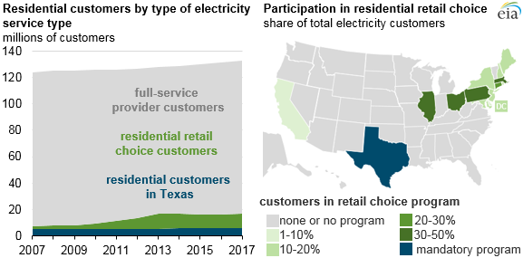
In some areas of the U.S., retail prices are no longer set by regulatory agencies
What do price structures
look like when retailers in a competitive
market set them?
Source: U.S. Energy Information Administration, Annual Electric Power Industry Report

Slide 48
Yet, I should note that interest in ‘customer choice’ in the U.S. may be on the decline
In states with residential retail choice programs, customers can elect to purchase their electricity directly from their choice of energy suppliers, with the electricity delivered to them by their local utility. The number of customers participating in retail choice programs peaked at 17.2 million customers (13% of total residential customers) in 2014 and has since declined, reaching 16.2 million customers (12% of the national total) in 2016 and 16.7 million customers (13% of the national total) in 2017.
Source: U.S. Energy Information Administration

Slide 49
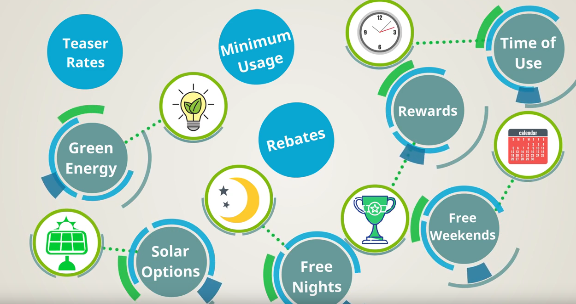
In Areas Opened to Competition

Slide 50

In areas opened to Retail Competition
Consumers can choose among many retailers (Retail Electric Providers is the term used in Texas) and among many pricing plans. However, many of the retailers are affiliates.
Together NRG and Vistra have a residential retail market share of over 75% in the Texas market (ERCOT).
So, pricing plans are used as a marketing strategy – to entice consumers to sign up for service with Retailer X.

Slide 51
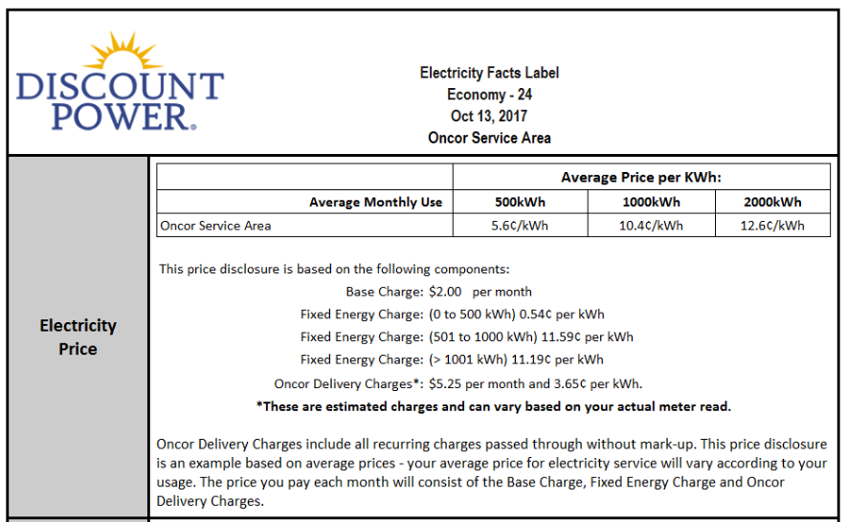
Increasing or Declining Block Pricing?
In a competitive retail market, you see some strange block structures –
sometimes called Slab Rates.

Slide 52
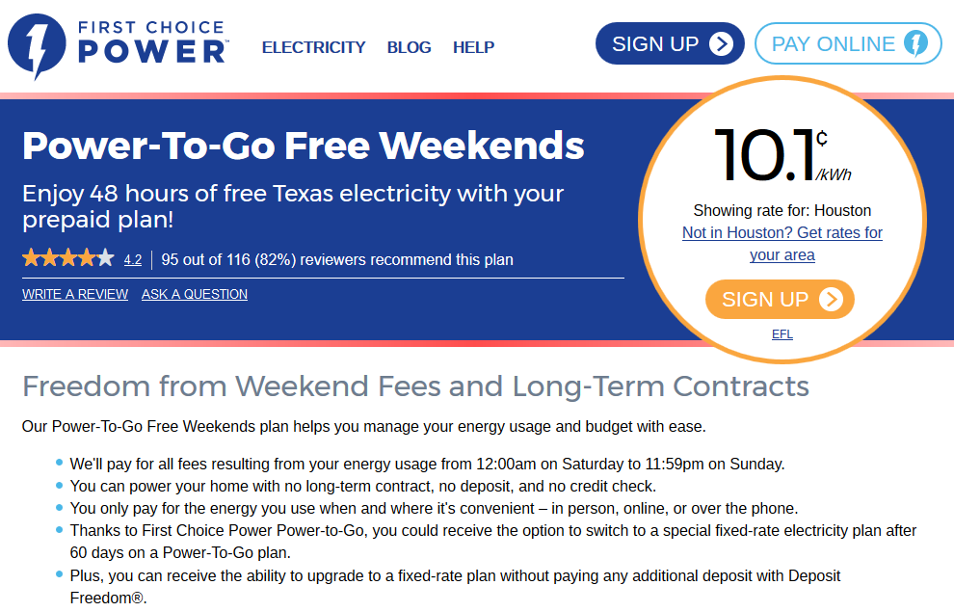
In areas opened to Retail Competition

Slide 53

In areas opened to Retail Competition

Slide 54
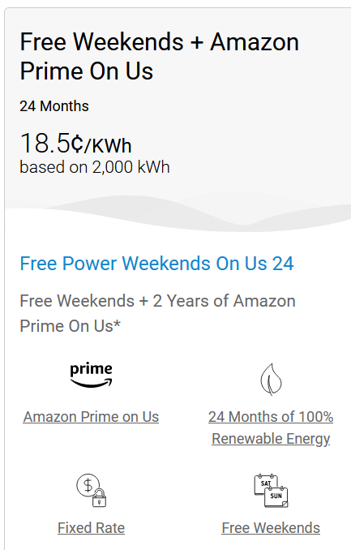
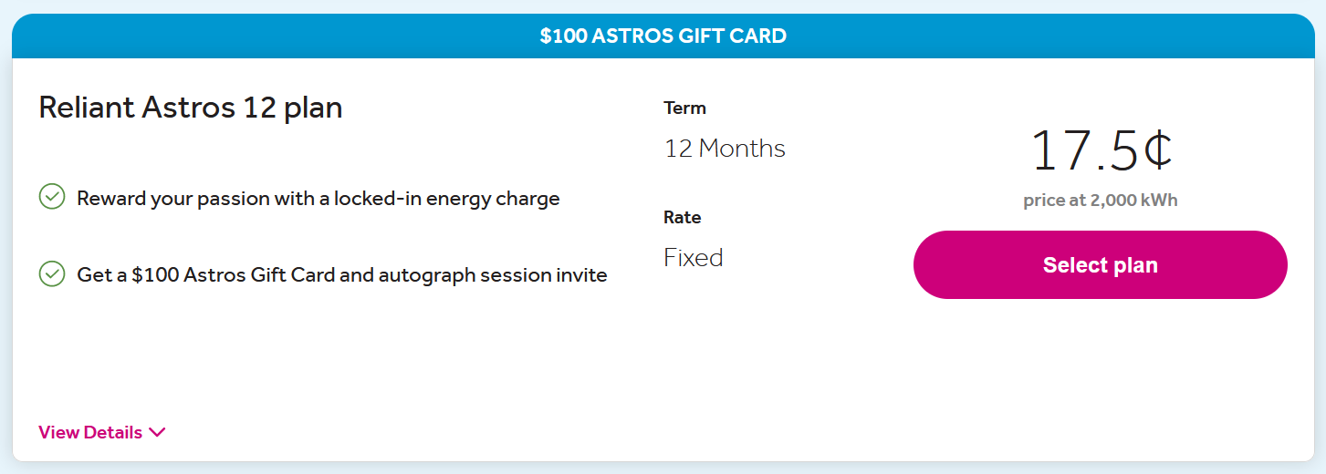
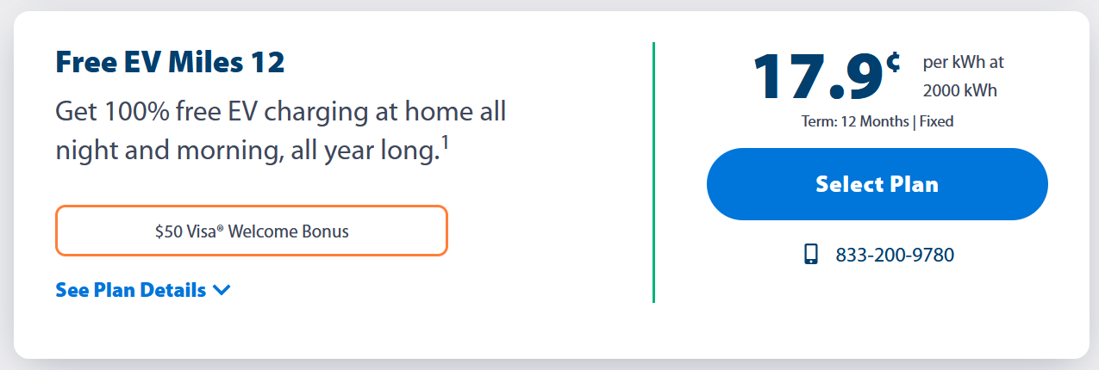
In areas opened to Retail Competition
From TXU

Slide 55
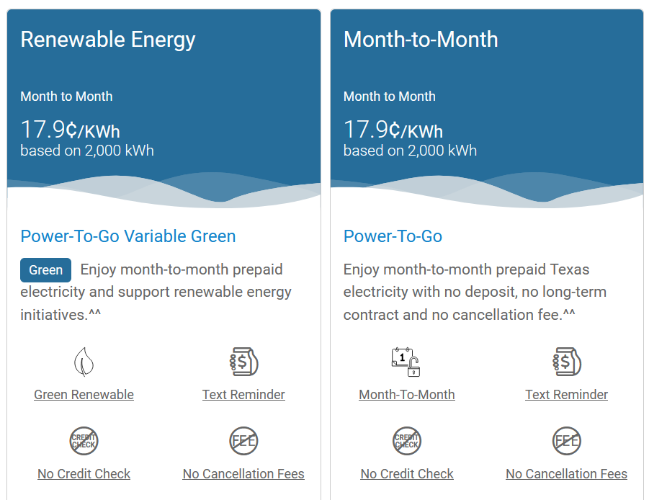
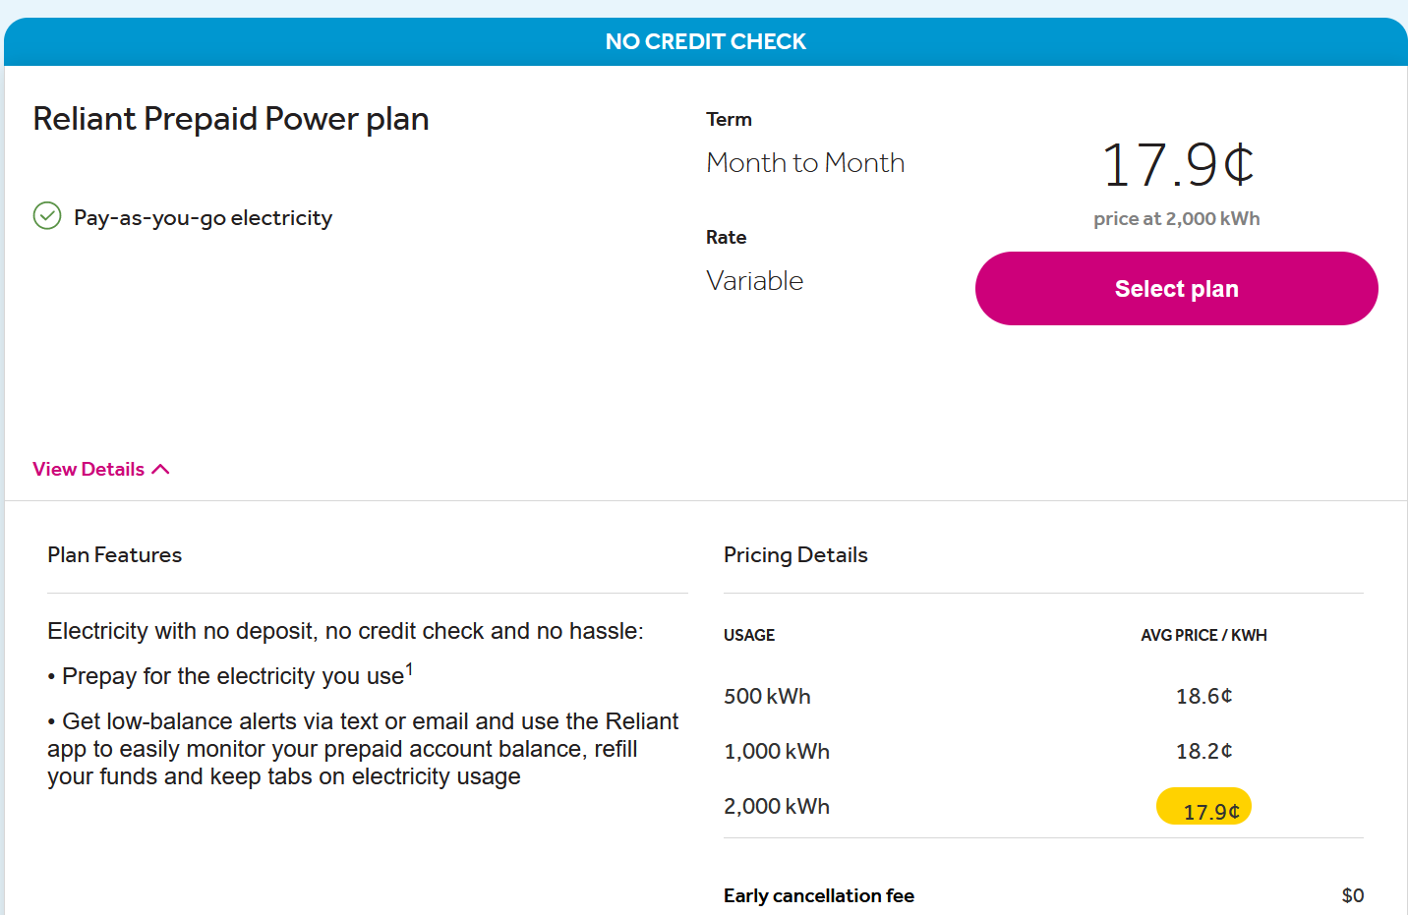
In areas opened to Retail Competition
From Direct Energy

Slide 56
Competitive Retailers are Offering a Good Variety of Residential Rate Options
  Based on my review of the Power to Choose website on November 14, 2023 for Houston rate plans:
  Overall, 166 rate options with a purported range of prices from 12.5 cents per kWh to 18.6 cents per kWh at a usage level of 1,000 kWh/month
  41 REPs are offering residential service (although many of the REPs have affiliate relationships with other REPs).
Time-of-Use plans: 9 from 5 REPs.
Variable rate plans: 9 plans. The remainder are fixed price plans.
100% Renewable plans: 37 offerings.
3 Prepay plans from 2 REPs. This is surprising since I’ve seen as many as 23 prepay plans in the past.
7 plans had minimum usage requirements.

Slide 57
Pricing to Industrial Energy Consumers in areas opened to competition
Industrial energy consumers can do many of the same things that load-serving entities (LSEs) do:
  Become their own “scheduling entity” and procure power like an LSE
  Buy “blocks” of power
  Buy energy from an Independent System Operator’s (ISO’s) market

Slide 58
Pricing to Industrial Energy Consumers in areas opened to competition
An example product for industrial energy consumers, Block and Index:
  Acquire the rights to a “block of power,” e.g., 20 MW for 24 hours/day for one year
  If demand >20 MW, buy the additional needed amount from the market at the market price
  If demand <20 MW, sell the unused energy back to the market and receive the market price

Slide 59
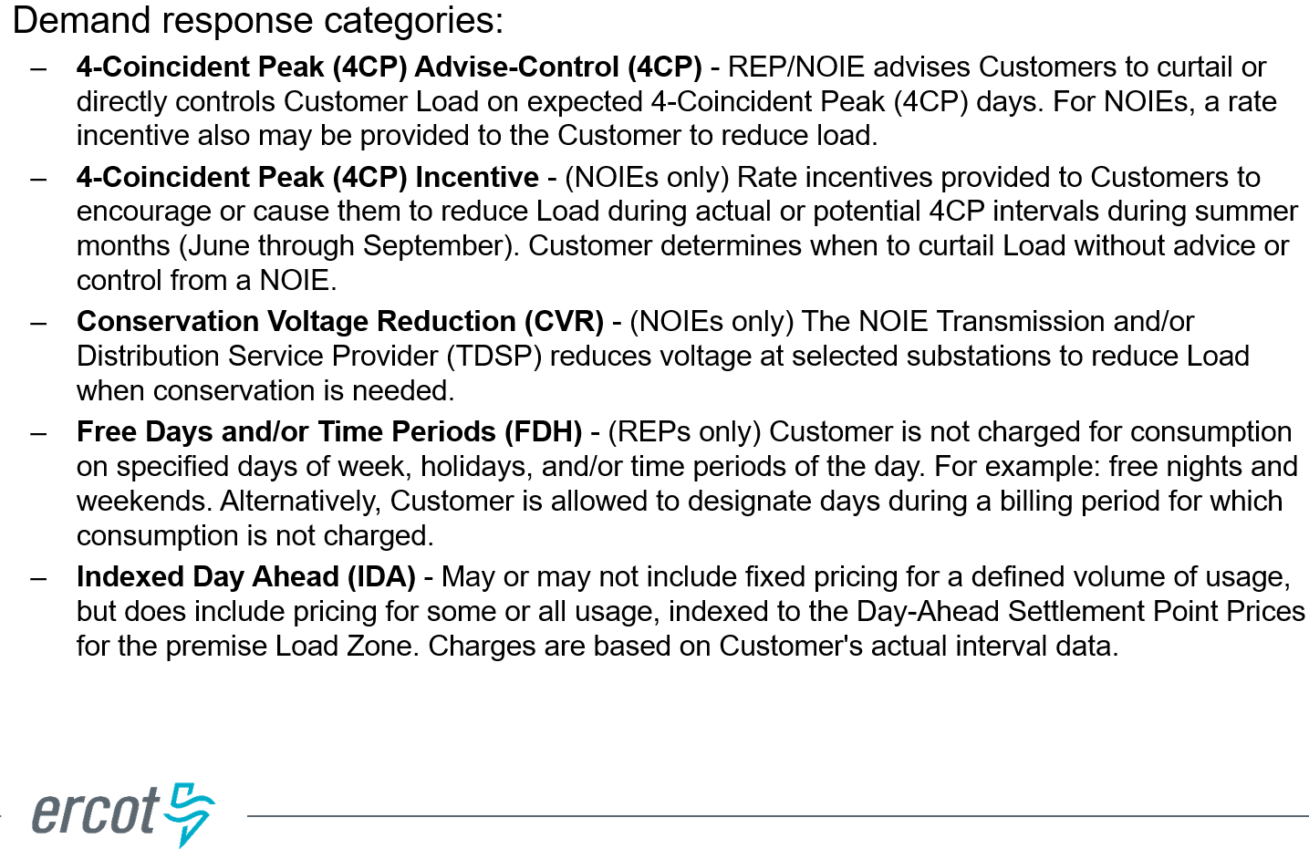
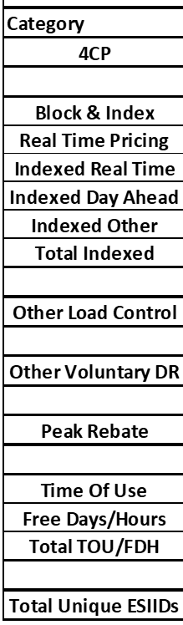
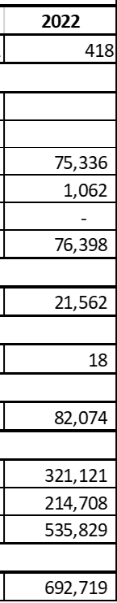
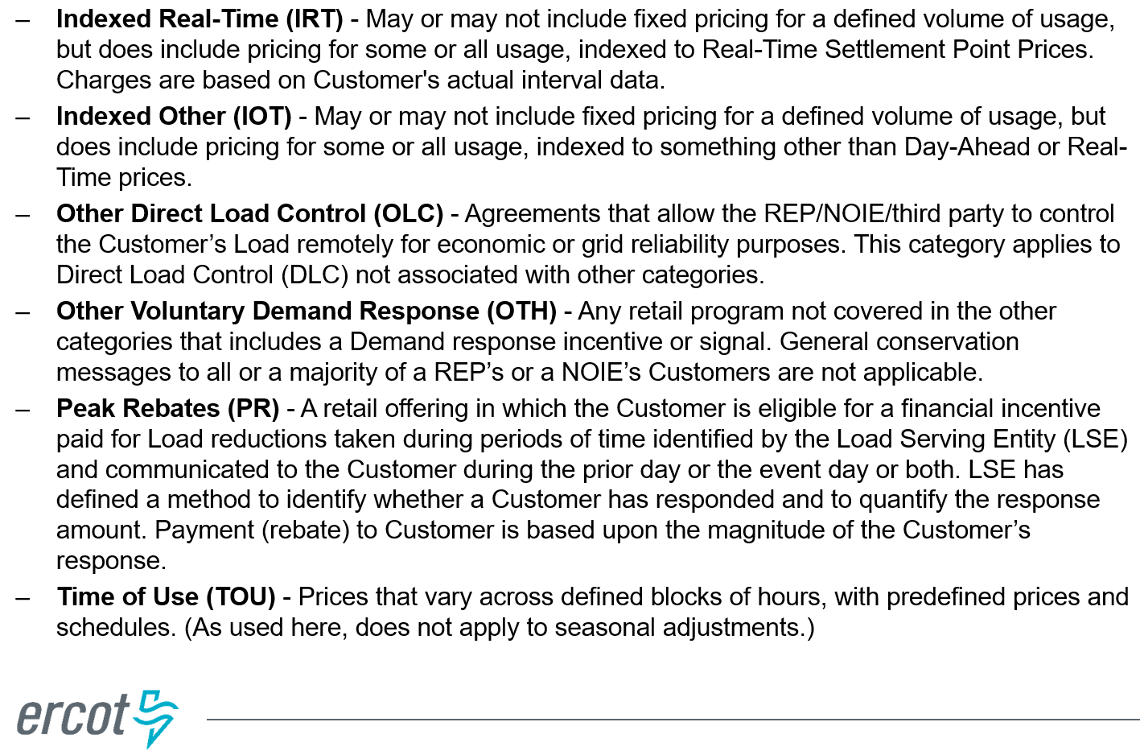
The number of customers in the Texas competitive retail market (ERCOT) on pricing plans designed to promote demand response

Slide 60
Observations regarding Pricing in Restructured Retail Markets
If the “shopping websites” report prices at 500, 1000, and 2000 kWh per month, retailers want to look competitive at those consumption levels. Consume 501, 1001, or 2001, and the actual prices jump!
Free weekends or evenings have been a big success. But those plans may be more-costly unless you respond to the price structure.
Teaser rates are common, where the first month is cheap and prices subsequently increase.
I’ve never seen a demand charge in a C&I contract for electrical energy (distinguished from T&D) in an area of Texas opened to retail competition:
  Perhaps this is unique to ERCOT, given its absence of a capacity market.
  But forward prices on the Intercontinental Exchange (ICE) don’t have capacity or demand charges either.

Slide 61
Topic Four
  Theory and Practice: Dynamic Pricing

Slide 62
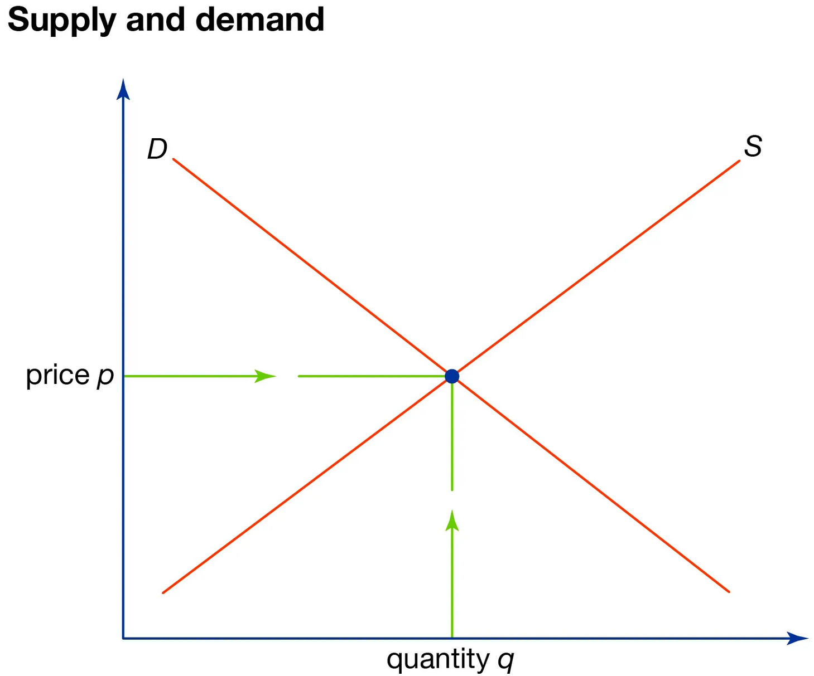
Matching Prices to Costs
In theory, prices should rise when there is scarcity or a shortage of supply.
A high price sends a signal to consumers to reduce consumption or move consumption to a lower-cost time period.
This will ration supply.
Congestion on the transmission network should similarly result in a high price to consumers.
Time-of-use and critical peak pricing has previously been discussed.
Now, let’s look at the theory in greater detail.
Reference: Bohn, Caramanis, Schweppe, Optimal pricing in electrical networks over space and time, Rand J of Economics, 1984.

Slide 63
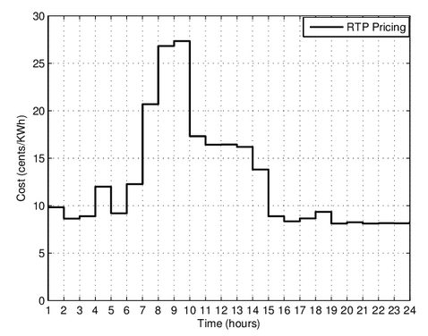
Real-Time Pricing
An efficient design based on marginal cost (MC) pricing is real-time pricing (RTP) with prices set to equate real-time (e.g., 5-minute or hourly) demands and supplies by location.
In a market where wholesale locational marginal prices (LMPs) are calculated, this would be LMP pricing – that is, reflect the wholesale LMPs in retail prices to consumers.
Except for very large users, RTP is seldom mandatory, due to high metering cost and customer objection.
Variants include two-part RTP to ensures that customers pay no more than bundled rate if they do not exceed baseline or if their load pattern does not change.

Slide 64

Matching Prices to Costs
Why can’t we just charge the market-clearing wholesale price of electricity generation to everyone?
Indeed, many large industrial energy consumers (and, even some residential consumers) buy power from the real-time market.
Moreover, some retailers are providing (or formerly provided, in Texas) wholesale power access to residential consumers. But, at least today, there are a lot of complications.

Slide 65
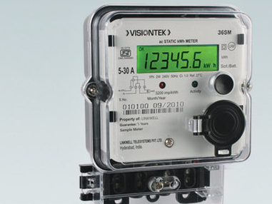
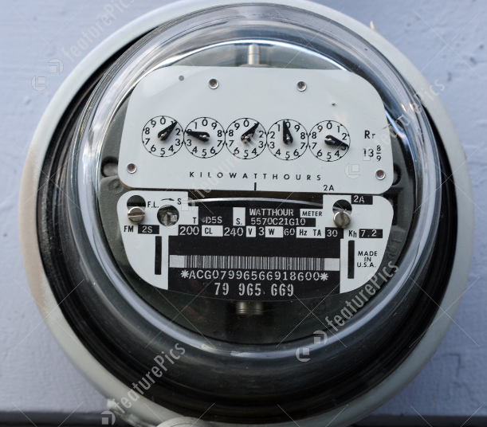
Matching Prices to Costs
Impediment: Metering
As mentioned earlier, nearly half of the residential electricity consumers in the U.S. have meters that only read “cumulative consumption.”
That is, the meters don’t record consumption during each period of time.
But, the other half of consumers do have meters that record the amount of electricity consumed each hour, or so. So, we’re getting there.
If you can’t measure it, it is difficult to charge consumers for it.

Slide 66

Impediment: Middlemen
Most of us don’t (or can’t) access the wholesale market directly.
Consumers usually purchase electricity through a Load-Serving Entity (“LSE”). This may be a regulated utility, a municipal utility, or a retailer in an area opened to retail competition).
These LSEs aggregate the needs of many consumers with different consumption patterns and buy aggregated blocks of energy from a wholesale market. The LSEs’ costs reflect the cost of serving the group and their hedging strategies, etc.

Slide 67
Impediment: Consumers’ Goals
Do consumers want constantly-changing prices? Or price stability? Prices change every 5 minutes for generators (and often every 15 minutes on the demand side of the market) in wholesale markets in the U.S.
Would it place a burden on consumers to monitor and respond to constantly-changing prices? Some of the “enabling technology” that would help consumers to automatically respond to prices is still in its infancy.
It might be economically-rational for risk-averse consumers to pay for a “hedged” or locked-in fixed price that doesn’t fluctuate over time.

Slide 68
The Revenue Reconciliation Problem
In a regulated setting, there is no assurance that market-based pricing will yield revenues equal to a regulated utility’s revenue requirement.
DYNAMIC PRICING

Slide 69
Impediment: Prices can get high

Slide 70
On the other hand, what if Marginal Cost is persistently too low?
Consider a market dominated by wind and solar generation.
They have zero or negligible variable operating cost and negligible marginal cost.
What if they are persistently “on-the-margin” and setting the market price?
Electricity “too cheap to meter” might sound great in the short-run. But will any suppliers want to invest in a market where energy generation doesn’t provide revenue?

Slide 71
Topic Five
  Economic Theory: Priority Service Pricing
Reference: Chao, H. and R. Wilson (1987) "Priority Service: Pricing, Investment and Market Organization,“ American Economic Review, 77 (5): 899-916.

Slide 72
Priority Pricing
This theoretical framework seeks to match the price of energy to the reliability of supply.
Energy that is provided with a low level of reliability (i.e., the supply could be curtailed or interrupted frequently and with little advanced notice to the consumer) should be priced low.
Energy that is provided with a high level of reliability (e.g., multiple distribution lines are constructed to serve the customer, the customer is among the last to be curtailed if there is a system emergency, battery backup is available) should pay the highest price.
Consumers who incur high “outage costs” (NASA, hospitals, high-tech manufacturing, individuals on medical life support equipment) would select high-price high-reliability service. Consumers who can tolerate outages (e.g., weekend cottages, steel mills, consumers with backup generators) would select low-cost service.

Slide 73
Interruptible and Curtailable service
Most larger electric utilities in the U.S. offer some form of voluntary interruptible or curtailable service, at least for larger energy consumers.
Prior to restructuring, Houston Lighting and Power Company had industrial tariffs providing “firm service,” interruptible service with 60 minutes notice, interruptible service with 10 minutes notice, and instantaneous interruptible service triggered by under-frequency relays. This menu of service options is very consistent with priority pricing.
Energy consumers on interruptible or curtailable tariffs, rates, or programs agree to be the first to have their service cut-off for a few hours if there is a system emergency.
In return for being to first customers to be cut-off, the energy consumers served under these tariffs receive a discount in their price of electricity.

Slide 74
Can we do this with residential electricity service?
In theory, yes.
Provide residential consumers with three (or more) reliability options: Your present level of reliability, a lower level of reliability with a lower price, and premium reliability service at a premium price.
What if this system had been in place during Winter Storm Uri in Texas in Feb. 2021? Then consumers with the cheaper service would have been the first ones to be shut-off. Instead, everyone that wasn’t on a circuit with a critical facility got shut off. If you were on the same circuit as a fire station or hospital, you never lost power.
In theory, you can “surgically curtail” specific residential customers with the remote connect/disconnect capabilities of advanced meters. But present software and bandwidth constraints make it challenging.
Demand response programs provide another way to get a similar outcome.

Slide 75
Topic Six
  Price Signals to Enable Consumers to make better Equipment Purchase Decisions
Reference: Borenstein and Bushnell (2021). Headwinds and Tailwinds: Implications of Inefficient Retail Energy Pricing for Energy Substitutes, Energy Institute at Haas

Slide 76
The Key Argument
Consumers make decisions regarding what appliances to buy by (in part) comparing the cost of operating each type of appliance. Think electric vehicle vs. gasoline vehicle. Natural gas water heater vs. electric water heater. Buy from grid vs. install rooftop solar.
Fixed costs on a utility bill aren’t relevant to the decision. You need be pay the customer charge on your electric or natural gas bill regardless of your usage decisions.
There are a lot of “fixed cost items” on electric bills that are being recovered through volumetric charges. This practice biases consumer decisions from an economic or social perspective.

Slide 77
The Key Argument
If the cost of externalities (e.g., CO2 emissions from power plants) was internalized and reflected in electric rates, this would help.
But, fixed costs should nonetheless be recovered through fixed charges to remove a key distortion.
Consumers should be exposed to the “social marginal costs” of consumer alternative energy resources.

Slide 78
Topic Seven
  Pareto Improvement as an Objective

Slide 79
Imagine this situation. . . .
You have a brilliant idea for a new optional pricing program that could benefit both the utility and its program participants.
The problem is – it is so creative and innovative that potential customers aren’t sure that it is going to save them any money, relative to the rate/tariff they presently are on.
So, it is really difficult to market this new program to prospective customers.

Slide 80
A possible solution. . . .
Design the new optional program so that if the customer does not change its behavior, the customer will pay the same amount.
But, if the customer changes consumption behavior, then the customer can benefit.

Slide 81
How can we pull this off?
Set a customer baseline load (CBL) that reflects the customer’s present or historical consumptions behavior. Perhaps a temporal load profile.
Apply the new pricing program to deviations from the CBL.
If there are no deviations from the CBL, then the customer gets the same bill as it would have received under the current or traditional tariff.
If the customer deviates its consumption pattern from the CBL, set the prices so that the customer and the utility benefits.

Slide 82
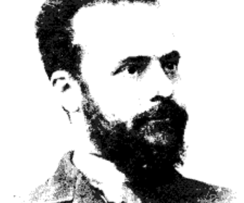
The goal here is “Pareto improvement”
What is Pareto improvement?
A situation where a change in resource allocation makes at least one person better off without making anyone else worse off. That is, it’s an action where you can improve someone's situation without negatively impacting another person, given the initial distribution of goods.
Vilfredo Federico Damaso Pareto (15 July 1848 – 19 August 1923) was an Italian, whose areas of interest included sociology, civil engineering, economics, political science, and philosophy. He made several important contributions to economics, particularly in the study of income distribution and in the analysis of individuals' choices. He was also responsible for popularizing the use of the term elite in social analysis. He introduced the concept of Pareto efficiency and helped develop the field of microeconomics.

Slide 83
This isn’t a new idea
Some of the real-time pricing programs implemented by regulated utilities use CBLs.
You can design other dynamic pricing programs (from simple time-of-use rates to critical peak pricing programs) with this in mind.
And there may be some challenges:
Do we need to weather-normalize the CBL or make other adjustments?
Could the utility or customer manipulate the CBL and gain?

Slide 84
Topic Eight
In an Era of Faster Growth in Electricity Demand

Slide 85
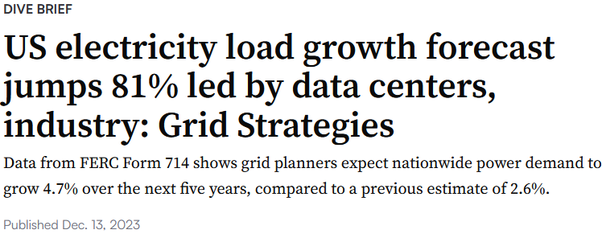
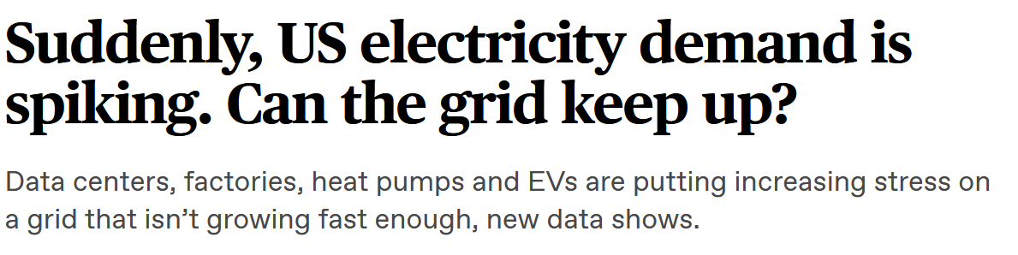
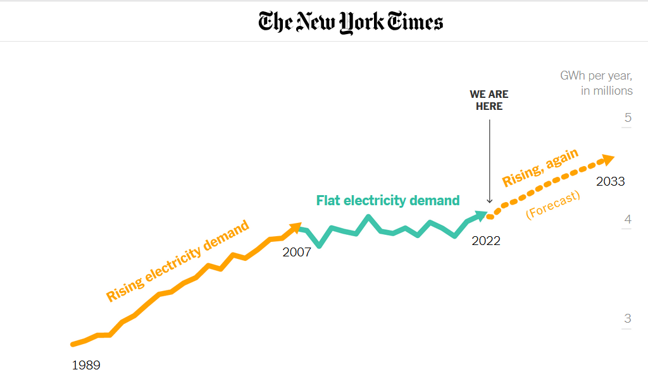
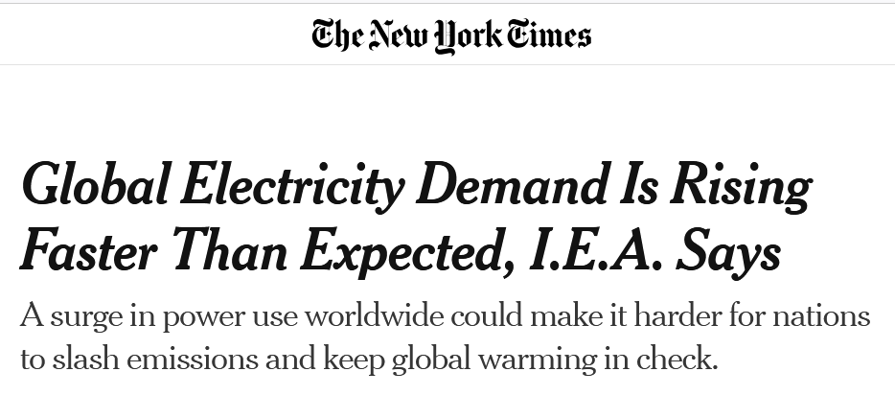
The Growth in Electricity Demand is Accelerating

Slide 86
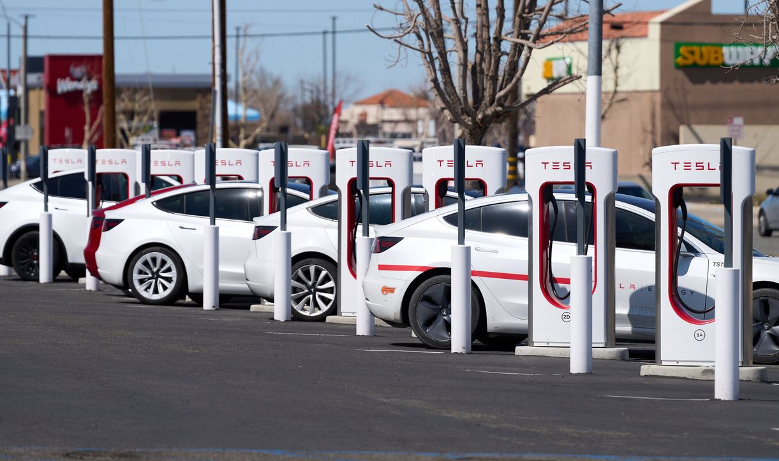
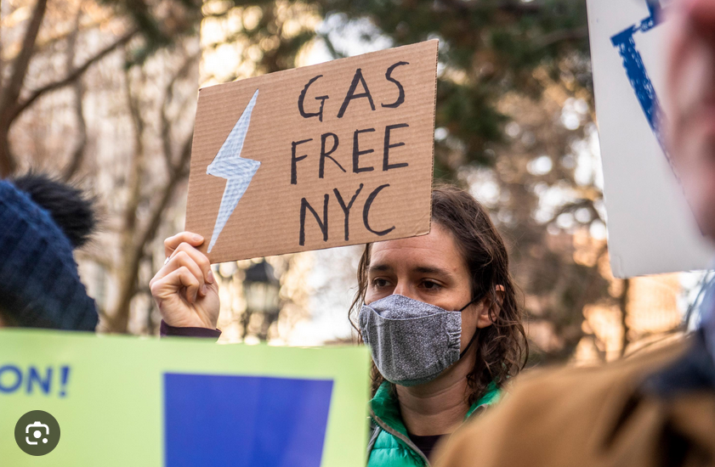
The Growth in Electricity Demand is Accelerating
Sources of electricity demand growth:
  Data centers
  Electric vehicles
  Fuel switching away from natural gas

Slide 87
The Growth in Electricity Demand is Accelerating
If supply-side investments have difficulty keeping-up with demand growth. . . .
  Focusing pricing to meet reliability goals becomes more important.
  Demand-side resources may need to come to the rescue.
  Regulatory lag becomes a greater problem. It may be increasingly important to provide cost recovery for new investments in utility infrastructure in a timely manner.

Slide 88
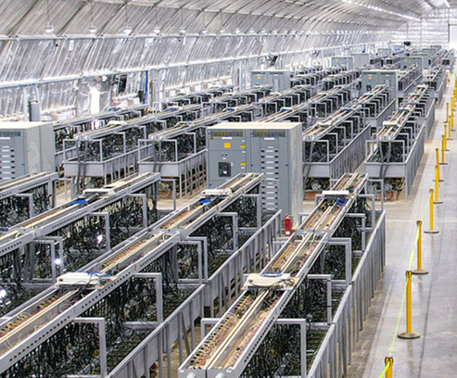
A lot of Growth is from Large Electricity-Intensive Projects
And load growth is coming from some industries that can easily close or move if market conditions change.
Do long-term investments in utility infrastructure make sense if we’re not completely sure whether the customer will locate in the service area? And we’re not sure how long the customer will stay. Is there a “stranded cost” or “stranded asset” problem?

Slide 89
Preparing for Higher Load Growth from Large Customers who might not be around in the long-term
Some possible approaches:
Special contracts? Each situation may be unique, suggesting that tariff changes that might affect all large customers might be inappropriate. One size may not fit all.
Demand ratchets? This might provide the utility with a more-stable revenue stream, when consumption is below some agreed-upon level. But might not address all problems.
Charge for any consumption in excess of an agreed-up level based on market prices?
Require new large loads to pay deposits before the utility embarks upon infrastructure investment?
Direct assignment of costs to new large customers?

Slide 90
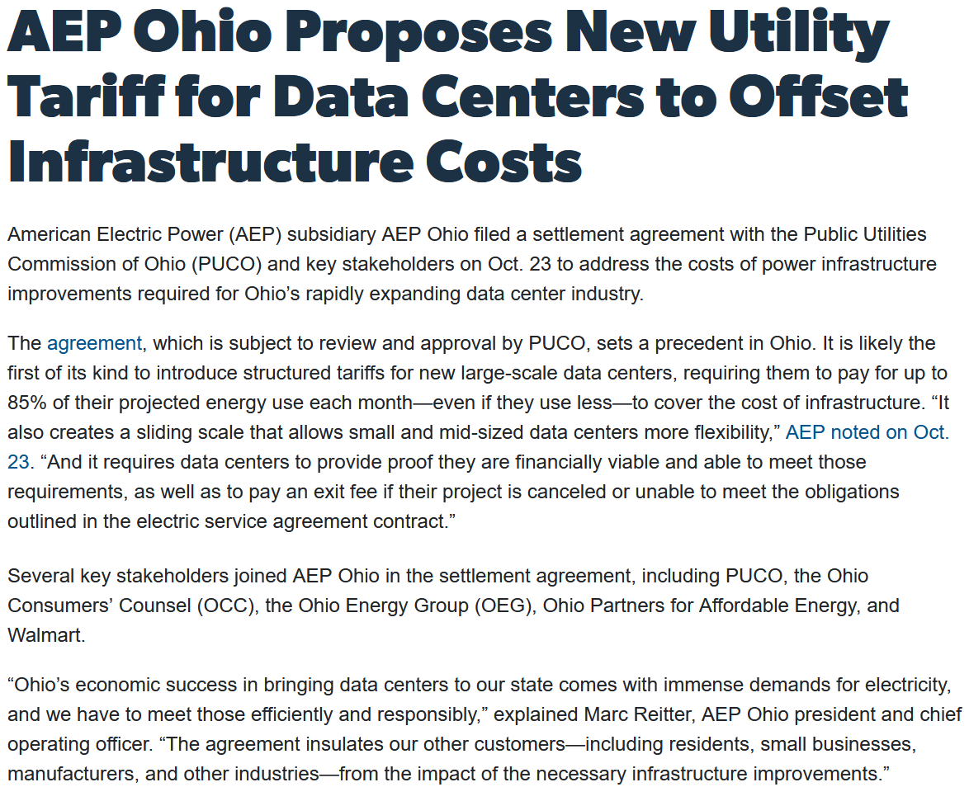

Slide 91

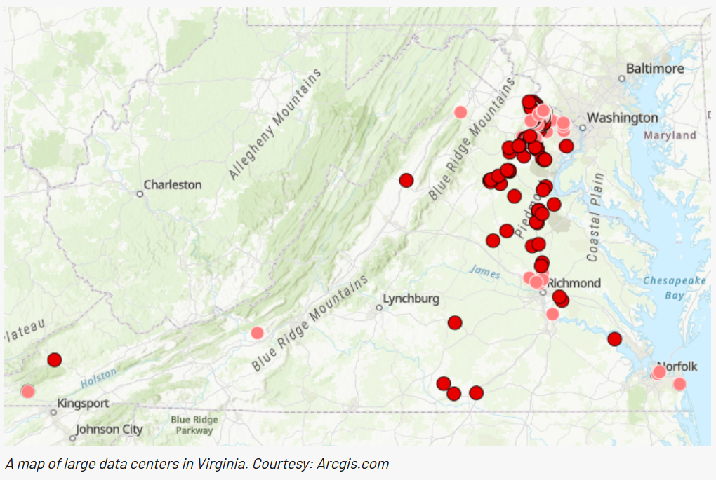
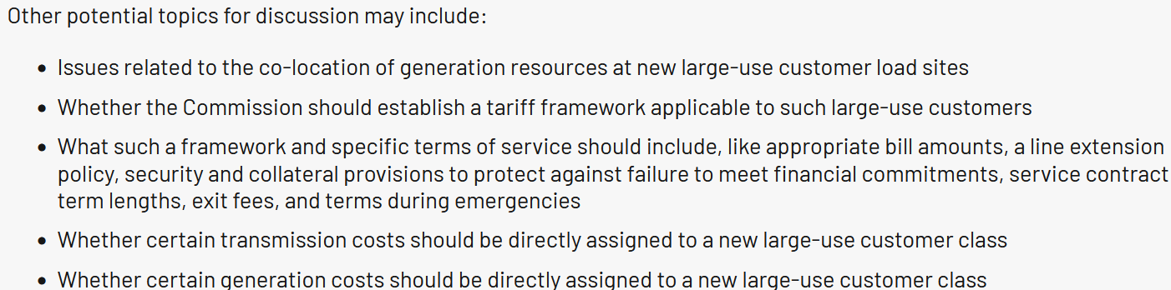

Slide 92
Topic Nine
The Smart Grid and Pricing in Distribution Networks

Slide 93
Prologue
One interesting topic of research explores how the principles of nodal or locational marginal pricing can be extended down to the distribution level.
This type of pricing has never been implemented in practice, as far as I know.
Moreover, there has been a lot of research over the past ten years on “micro grids” and “energy collectives” with a similar theme.

Slide 94
Impetus
Of course, we can experience congestion on the distribution system.
In a local area – e.g., a neighborhood – we can experience supply shortages for electricity.
These local problems are largely ignored by an independent system operator that sets prices at various nodes or busses where power plants are connected.
We can send better price signals to consumers if prices also reflect the economic cost of distribution or local problems.

Slide 95
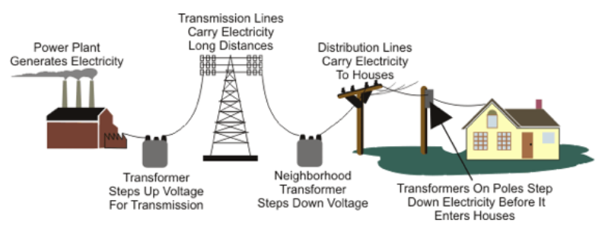
Let’s look at the key functions
Generation
Transmission
Distribution
Retail

Slide 96
Optimal Dispatch of both Generation and Loads (Demand)
The point at which demand and supply curves intersect yields a price.
At its simplest, a locational marginal price (LMP) reflects:
The marginal operating cost of the resource “on the margin” at a particular time.
Any increased cost due to transmission constraints.
Line losses.
In an optimization framework, select the resources which will:
Maximize consumer utility or welfare; or minimize system cost
Subject to capacity constraints on generating units
Subject to capacity constraints on transmission lines
Subject to a power balance constraint, i.e., supply must meet demand at all times

Slide 97
If we don’t properly reflect distribution system costs in time-varying prices
The distribution system must be over-built (i.e., built to a larger scale than in economically efficient) in order to maintain reliability.
  Generation (power plants) and transmission must be over-built for this reason, also.
  This is another way of saying that if we can use high prices to reduce use on the distribution system when the distribution network is over-worked, we could get by with a smaller distribution network.
Consumers of electricity do not make efficient decisions regarding investment in production and consumption assets.
  They probably invest too much in air conditioning than is optimal, since they don’t face the real cost of air conditioning in prices.
  They invest too little in devices that allow consuming assets to be turned off during periods of high prices.
Consumers have too little incentive to invest in local generation, which is a substitute for the network at times of local network congestion.

Slide 98
Using a Smart Grid
The required infrastructure:
  Compute the efficient nodal prices on the distribution network
  Install devices capable of metering electricity consumption at each node on the distribution network at different points in time
  Install equipment and appliances at customer sites that can respond to market conditions
The situation.
  (Absent demand response actions) Consumers won’t respond to market conditions unless it is reflected in the prices they pay.

Slide 99
The Types of Response that Could be Achieved
You program your water heater, refrigerator, and pool pump to turn off when the local price gets above some level.
Your thermostat changes the temperature a couple degrees to reduce air conditioning or space heating electricity use when the price gets high.
Your home storage unit discharges with the price is high and recharges when the price of electricity is low.
You charge you electric vehicle during off-peak periods.
Or, you might let your electricity provider control or dispatch this equipment for you.
You have no economic incentive to program your appliances to take these actions now. (And, you might not have an incentive to buy that Tesla PowerWall energy storage device unless you are on dynamic pricing or value reliability very highly.) But if you faced real-time prices that reflected all generation, transmission, and distribution costs, you might.

Slide 100
If a distribution utility calculates distribution prices and an ISO calculates wholesale prices. . . .
Yes, with sufficient communication, you could decentralize various dispatch decisions. That is,
  An office building could operate the electricity-using equipment and local generation assets based on optimal prices provided by a distribution utility.
  A distribution utility could then use supply and demand information from the campus to calculate optimal prices on the distribution system, combining optimal wholesale electricity market prices distribution prices based on the shadow prices associated with local distribution system constraints.
  Supply and demand on distribution systems could be used by an independent system operator (ISO) to calculate the optimal prices at various nodes on the transmission system, based on wholesale market conditions (offers by generators to sell power, transmission constraints, etc.).

Slide 101
If a distribution utility calculates distribution prices and an ISO calculates wholesale prices. . . .
Yet this is complicated because:
  The distribution utility needs the wholesale nodal prices in order to calculate the optimal distribution-level nodal prices
  The ISO cannot calculate the wholesale nodal prices (LMPs) until it knows supply and demand on the numerous distribution systems
  For example, a price spike in a part of a distribution network could prompt a local response (demand reduction or an injection of power into the grid from a backup generation source) that would then affect wholesale level supply and demand and change the wholesale nodal price, that would then change the distribution-level nodal prices, that would then. . . .

Slide 102
Topic Ten
Energy Collectives

Slide 103
Peer-to-Peer Energy Collectives
Imagine you could produce your own electricity by installing solar panels on the roof, and share leftover energy with friends or neighbors who need it. Not only will you be helping the planet by generating and using green energy, but you will also be supporting people in your community. Like AirBnb and Uber, peer-to-peer energy trading allows people to sell electricity to others directly.
Peer-to-peer energy trading is being tested in many places, from London (United Kingdom), where residents in social housing exchange energy left over from their share of a communal solar panel with each other, to Medellín (Colombia), where residents of disadvantaged areas sell self-produced energy to residents of wealthier areas.
Source: International Energy Agency

Slide 104
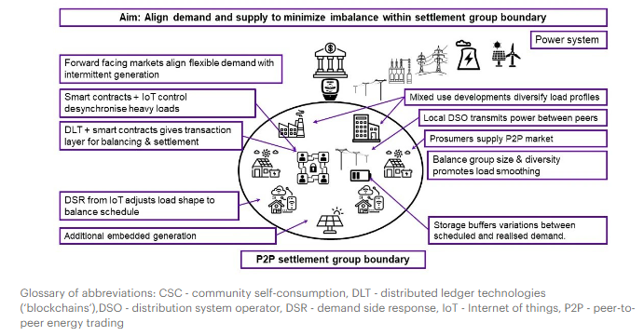
Peer-to-Peer Energy Collectives
Source: International Energy Agency

Slide 105
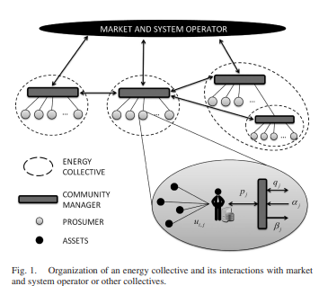
Energy Collectives
The math problem here is to find
optimal ways of “sharing” resources,
such as solar generation, wind generation,
energy storage to meet the energy needs
of the community.
There are dispatch (operations) and investment
problems.
Perhaps this is interconnected to a larger
grid. Perhaps it isn’t.

Slide 106
Final Thoughts
  Ideally, rate design should closely follow cost-of-service results. But there are always deviations for practical and public policy reasons.
  Reasonable people may disagree on the best approaches and rate structures.

Slide 107
Thank you
Jay Zarnikau
The University of Texas at Austin
jayz@utexas.edu

Slide 108
APPENDIX: Some Definitions

Slide 109
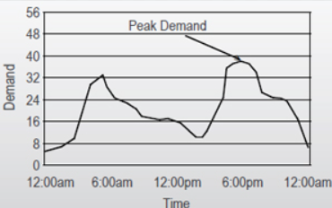
Some Basic Definitions
Energy. This has a few different meanings:
  The definition used in physics and engineering: the ability to do work.
  The definition used in economics: A productive input to a process
  We will often measure it in MWh, kWh, or Btus
Demand
  An instantaneous measure of power, measured in kW or MW
Capacity
  A limit. This will often be expressed in kW or MW, although the constraints on hydroelectric generation are usually expressed differently -- as an energy measure

Slide 110
Definitions
Load factor is the actual amount of kilowatt-hours (kWh) delivered on a system in a designated period of time, as opposed to the total possible kWh that could be delivered on a system in a designated period of time.
Load Factor = Average Load/Peak Load

Slide 111
Locational Marginal Price (LMP)
The short-run marginal cost of providing an additional unit of energy at the location where energy is delivered or received. It is based on forecasted system conditions and the latest real-time security constrained economic dispatch program solution.
Components may include the cost of generating an additional unit of energy from the generating unit “on-the-margin,” a transmission congestion premium (i.e., the additional cost imposed by transmission constraints), and transmission line losses.

Slide 112
Peak Demand: CP vs. NCP
Coincident Peak (CP)
A customer’s demand during the time when electricity demand systemwide is the highest.
Non-Coincident Peak (NCP)
The sum of the individual maximum demands regardless of time of occurrence within a specified period.

